Slide 1
Update slide
Software tools relevant to Finance Automation

Slide 2
Quick Introduction
Joe Paget FCA

Slide 3
Your Automation Journey
How do you begin your automation journey? 24th Jan 2023
What are the common automation use cases? 18th Apr 2023
How do you drive a digital transformation culture? 25th Jul 2023
What software tools are relevant to automation within Finance? 21st Nov 2023
Notes:
[Click]

Slide 4
Identifying Opportunities for Automation
Key Accounting Processes
ORDER OF PRIORITY
Bank Transactions
Receipts & Invoices
MAKE AN ASSESSMENT OF YOUR EXISTING ACCOUNTS SOLUTION
Procure to Pay
Order to Cash
MAXIMISE THE VALUE FROM YOUR ACCOUNTS SOLUTION
Reconciling Data
Project Accounting
IDENTIFY GAPS IN FUNCTIONALITY
Forecasting

Slide 5
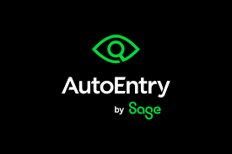
Data Entry
Identify areas of manual data entry
Bank Statements
Receipts & Invoices
Enable Bank Feeds
Extract Data and post directly into ledgers

Slide 6
Procure to Pay
A P2P or PTP Solution enables the automation of the entire procurement process within a business, from the originating requisition to the payment of the supplier
Common elements include:
Requisition and approval
Supplier Identification
Purchase order creation
Goods or Services receipting
Invoice Matching and exception approval
Payment processing

Slide 7
Order to Cash
An O2C process covers the entire lifecycle from how a customer places an order to the time when payment is received
Common processes include:
Order Entry
Order processing
Order Fulfillment
Invoicing
Accounts Receivable
Payment Processing
Credit Control
Collections

Slide 8
Reconciliations
Reconciling data between systems is a task that can consume many hours across finance teams each month
Best practice is to:
Perform Regularly
Automate the process
Standardize Data Formats
Implement Checks and Balances
Trace back to Source Documents
Continuous Monitoring

Slide 9
Project Accounting / Revenue Recognition
Keeping an accurate track of costs, revenue and overall financial performance can test the functionality of your existing accounting system
Look for functionality that includes:
Cost Tracking
Revenue Recognition
Resource Management
Time Tracking
User Friendly Interface

Slide 10
Forecasting Software
When trying to plan and predict future financial performance Excel based models can quickly begin to hold you back
Look for functionality that includes:
Scenario Planning
ERP and Finance System Integration
Historical Analysis and Predictive Tools

Slide 11
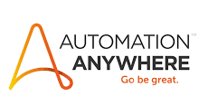
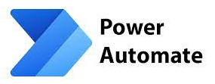
Dedicated Tools
Robotic Process Automation
Analytical Process Automation

Slide 12
Any Questions?
For more information:
Visit https://4threvolution.co.uk/applications/
Email: joe.paget@4threvolution.co.uk
Call Joe Paget +44 7795505783

