Slide 1


12 ESSENTIALS
you need to know
FOR
EXPANSION

Slide 2

About US Expansion Partners
US Expansion Partners assists European technology companies with all aspects of launching, managing, and scaling operations in the United States including entity formation, corporate governance & compliance, financial reporting, talent acquisition, fundraising and go-to-market strategy.

Slide 3












Table of Contents
4
5
6
7
Entity Formation
Accounting
Banking
Site Selection
11
10
9
8
HR
Visas
Taxes
Insurance
12
13
14
15
Employees
Go-To-Market
Intellectual Property
Capital

Slide 4

Forming A Corporate Entity
Creating a US Corporation
Entity Type -> LLC, S-Corporation, C-Corporation*
State of Incorporation -> Delaware is Common but other options exist
Articles of Incorporation
Bylaws & Officers
Federal Identification Number (FEIN)
State of Domicile
State Tax Withholdings Number
State Unemployment Number

Slide 5

Accounting & Transfer Pricing
US Accounting Operations
CPA firm for State and Federal tax returns
Transfer Pricing Determination
Accounting Software
Bookkeeping
  Monthly & Annual Financial Reporting
  Accounts Payable
  Accounts Receivables
  1099 Administration

Slide 6

US Banking
Establish US Banking
Required for US Business
ACH System
“KYC” Challenges
Items Needed:
Physical Address
Federal Employer Identification Number (FEIN)
Articles of Incorporation
Named Officers

Slide 7

Site Selection
Site Selection Considerations
Physical Office vs. “Virtual” Office Address
Operating Hours Overlay
State Income Tax Rate
Access to Talent
Proximity to Customers and Partners
Cost of Living
Ease of Travel

Slide 8

Insurance
Your US Subsidiary will be required to have certain insurance
coverages and will want to have additional option coverages:
Statutory Insurance:
  General Liability Insurance
  Worker’s Compensation (when you have employees)
Additional Coverages:
  Errors and Omissions
  Cyber and Privacy
  Directors & Officers
  Employment Practices

Slide 9
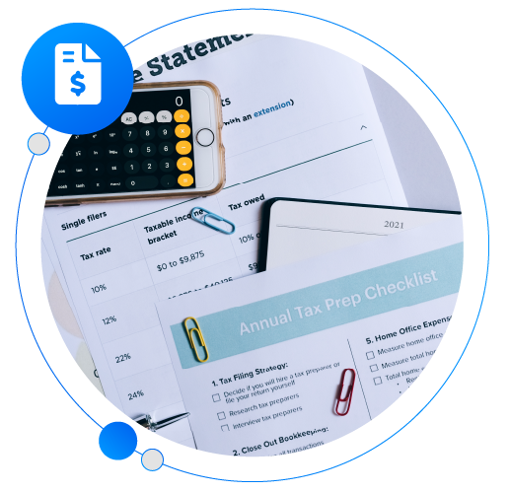
Corporate Taxes
There are a myriad of federal, state, and local tax laws your US
corporation will need to comply with and pay.
Federal Taxes:
  Federal Corporate Income Tax
  Federal Insurance Contribution Act (FICA)
  Federal Unemployment Tax Act (FUTA)
State Taxes
  State Corporate Income Tax
  State Unemployment Insurance (SUI)
  Sales Tax
  Business Property Tax
  Franchise Tax

Slide 10
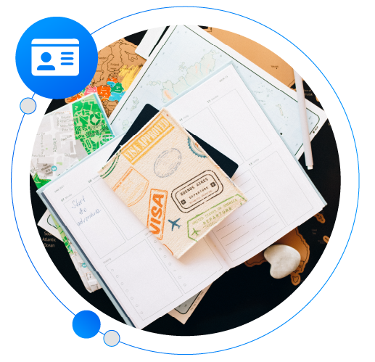
Immigration & Visas
There are multiple immigration and Visa options companies
opening a US subsidiary can consider.
E Visas: Companies needing a short- or long-term supervisor, investor, or essential employee in the US.
L Visas: Companies with at least one entity abroad, and one in the US. L visas allow companies to transfer employees in the short-term.
H1-B Visas: Companies needing specialized employees in the short term. They are capped at 65,000 persons with bachelor’s degrees and 20,000 with US master’s degrees.
PERMs: Companies needing employees to reside in the US permanently. The PERM process is needed to file for both EB-2 and EB-3 employment-based green cards.

Slide 11

Human Resources
Employee administration and compliance in the US will be very
different from your home country. Below are the broad categories related to human resources management in the US:
Payroll Administration
Employee Benefits
ESOP
Talent & Culture
Compliance
Technology
You may want to consider using a PEO

Slide 12

Employee Costs
There are both compulsory employee costs and optional employee costs (such as health insurance, 401K, etc.). Below is a summary of the employee costs.
Compulsory Costs
  Federal Unemployment Tax (FUTA): 6% of wages
  State Unemployment Insurance Tax (SUI): varies by state
  Federal Insurance Contribution Act Tax (FICA): 7.65% of wages
  Worker’s Compensation Insurance: varies by job and state
Additional Costs
  Health Insurance
  401K
  ESOP

Slide 13

Go-To-Market
You’ll want to reexamine your entire go-to-market strategy
for the US and consider the following items:
Product-Market Fit
Branding and Positioning
Pricing Strategy
Strategic Partners
Sales Approach
Demand Generation
US Contracts & Agreements

Slide 14

Intellectual Property
You’ll want to ensure your company’s Intellectual Property is protected in the United States. Below are a few items you should know about intellectual property in the US:
Patents
  12-15 Months for Consumer Products
  2-4 years for Enterprise Software
  Must File Within the First 12 Months
  Paris Convention or Patent Cooperation Treaty
Trademarks
  2 Year Average Turnaround
  US is a Use Based System

Slide 15

Raising Venture Capital
Below are a few key items that will be helpful to know
when raising venture capital in the US:
Target the Right VC Firms
Personal Introductions
Valuation Expectations
No NDA’s
100+ Pitches
Re-Vesting for Founders
No Finder’s Fees
US Entity or HQ

Slide 16

Why North Carolina?
Here are 7 reasons why you will want to locate your US subsidiary’s
headquarters in the state of North Carolina:
Business Friendly Environment (2.5% Corporate Income Tax Rate)
Highly Educated Workforce
Strong Startup Community & Ecosystem
Leading Tech Brands Call North Carolina Home
HQ for 13 Fortune 500 Companies
Ideal Location for International Business
North Carolina Quality of Living

Slide 17

QUESTIONS?
David Rose
CEO • US Expansion Partners
david@usexpansionpartners.com • 1-919-949-2025 • @davidbrose

